Slide 1
Niner Transit Data
Autumn Horrell, Jaren Robbins, Felipe Orrego, Django Yepidan, Thien Nguyen

Slide 2
The problem
Overview
Our Response
The Niner Transit system is a widely used transportation service provided by UNCC for students and faculty to use. However, with the exponential growth of riders, the system needs to adapt to the increasing efficiency standards.
Through analyzing the data given to us, we will visualize the information to make conclusions regarding the optimization of the transit system.

Slide 3
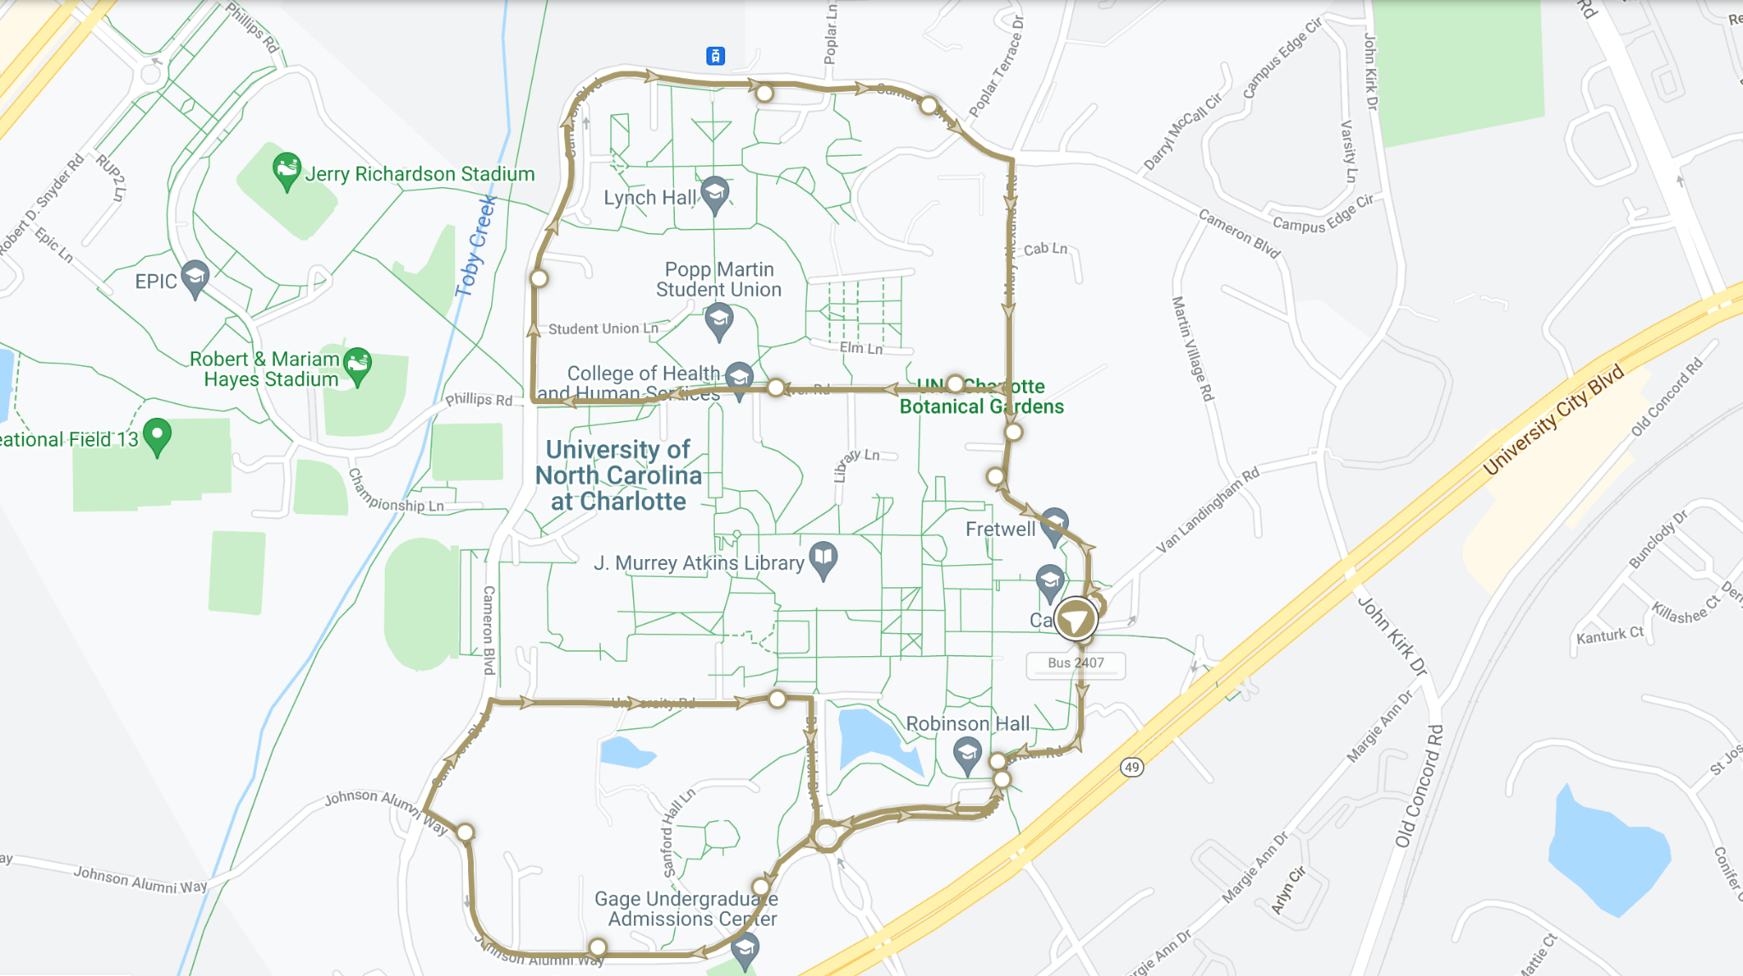
Overview of the Routes
Gold
The gold route focuses on looping around the major points across campus by stopping at the campus's north and south parts.

Slide 4
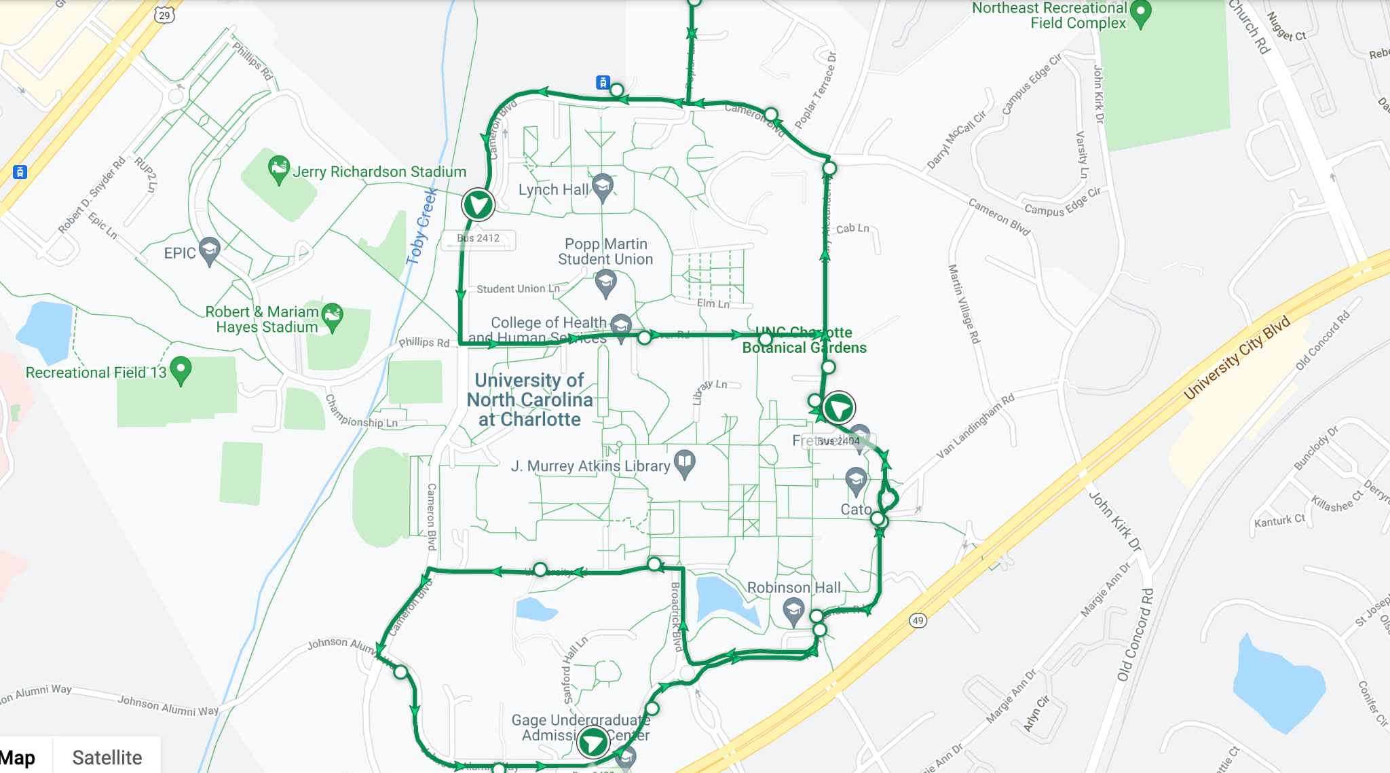
Overview of the Routes
Green
The green route focuses on looping around the major points across campus by stopping at the campus's north and south parts. This route is identical to the Gold route but navigates in the opposite direction.

Slide 5
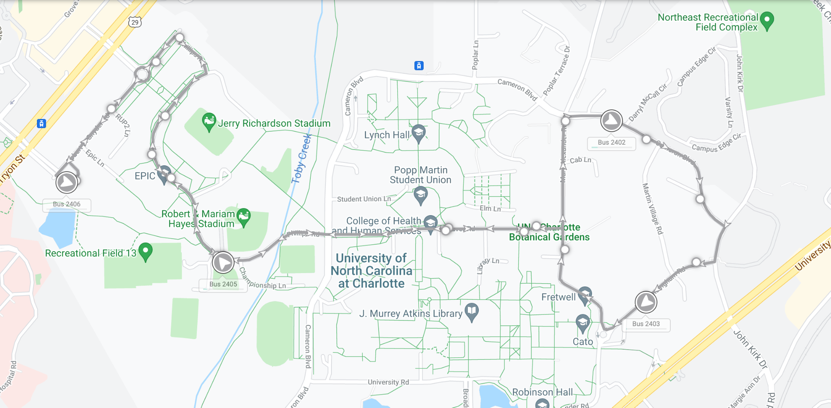
Overview of the Routes
Silver
The silver route travels towards the engineering portion of the UNCC campus and some residential areas.

Slide 6
Data Visualization
Our team used the data provided to determine the average amount of passengers getting on and off at each stop location. We then used this to create graphs to showcase the least and most used stops.
Each data set has three columns:
Stop - The name of the stop
AvgOn - The average amount of people getting on the bus
AvgOff - The average amount of people getting off the bus

Slide 7
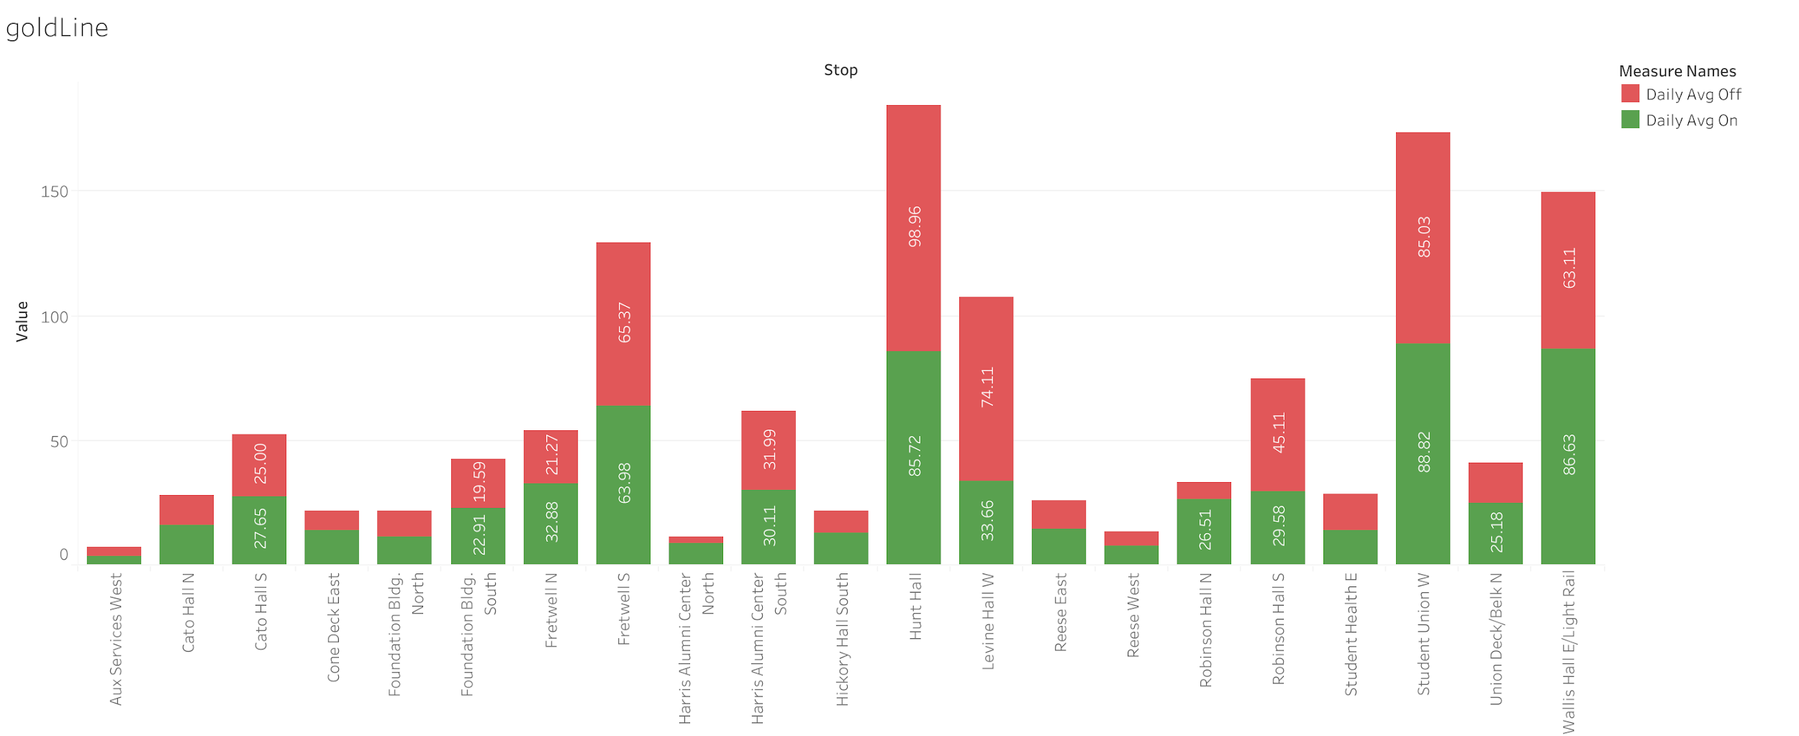
Gold Route

Slide 8
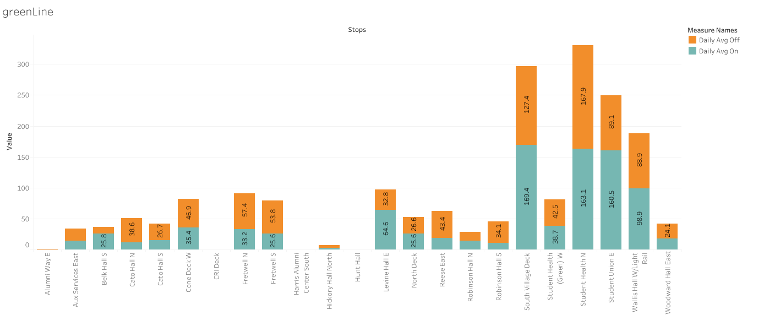
Green Route

Slide 9
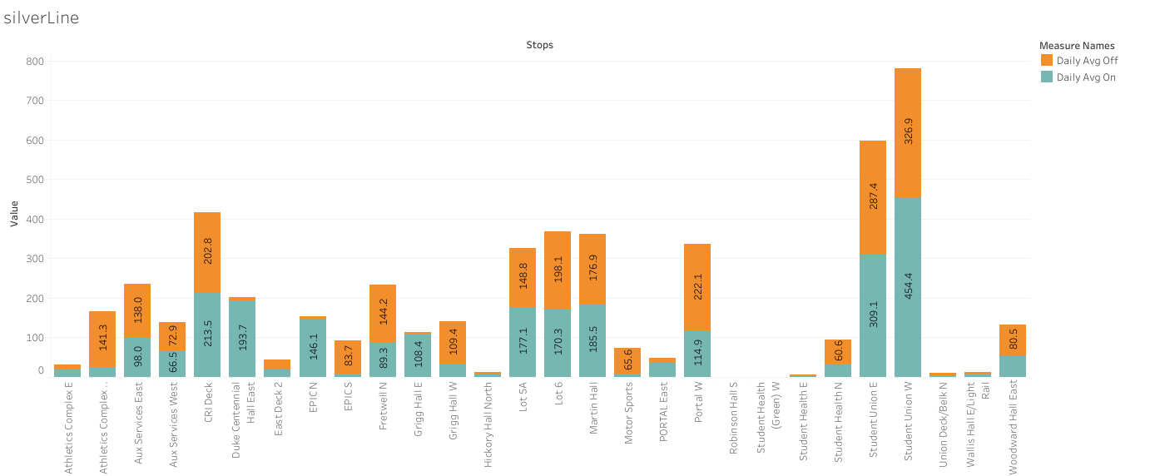
Silver Route

